Slide 1





DFT bypass with machine learning for the prediction of exciton binding energy in perovskite solar cells
Migon Choi (Duke University)
Aaron Peng (University of Chicago)
Cindy Wong (University of Illinois Urbana-Champaign)
Is this important?
Nah just toss it

Slide 2
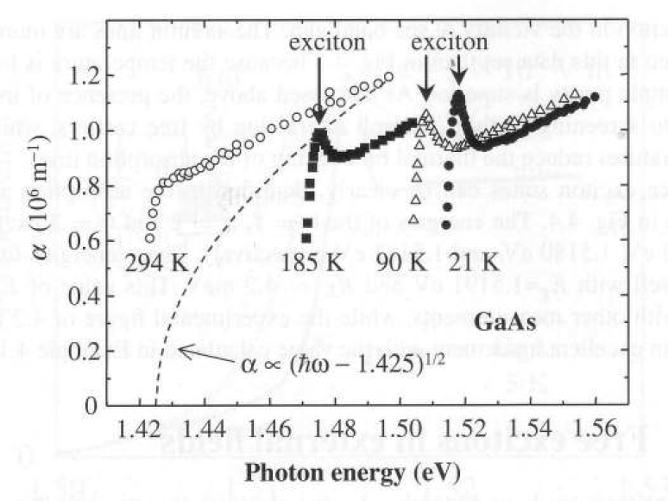
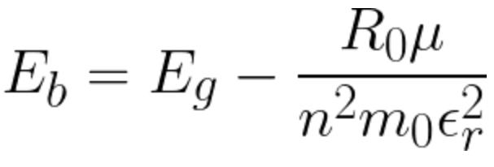
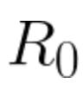
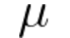
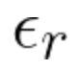
Optical properties with and without excitonic effects in direct semiconductors
Independent-electron approximation
Inclusion of excitonic effects
Ex: GaAs with and without excitonic effects [1]
Conduction band
Exciton level E_{b}
absorption
Band gap E_{g}
emission
[1] Sturge, M. Physical Review, (1962) 127(3), 768.
Valence band
E_{g} @ 294K: 1.425eV
Rydberg constant
Reduced effective mass
Dielectric constant/ screening term

Slide 3
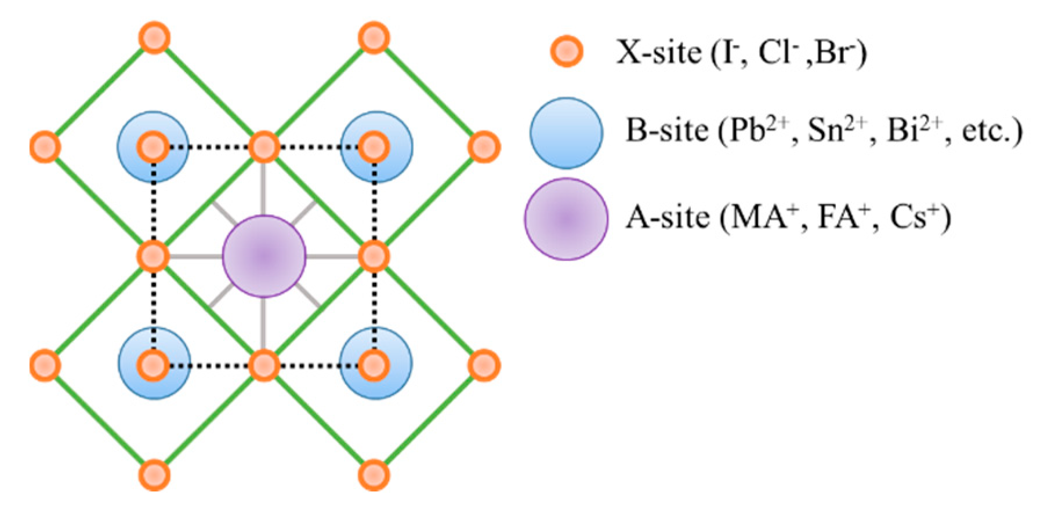
Excitons in perovskites
Highly polarizable lattice
Major controversies in calculating exciton binding energy
Rydberg constant
Reduced effective mass
Dielectric constant/ screening term
Which dielectric constant to use? Static (eps = 5) or high-frequency one (eps = 30)?
How to account for change in Eb w.r.t temperature?

Slide 4


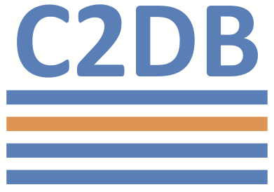
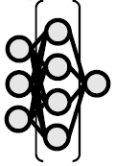
Ablation of features in deep NN to obtain most relevant features
descriptors
34,940 ABX3 materials
23 features
23,112 ABX3 materials
7 features
120 ABX3 materials
101 features
Fully connected deep NN
Band Gap
Formation Energy
Stability
Ionic radii and atomic volume of abx
Lattice constant
…
Exciton binding energy
LassoCV as classical ML benchmark

